Slide 1
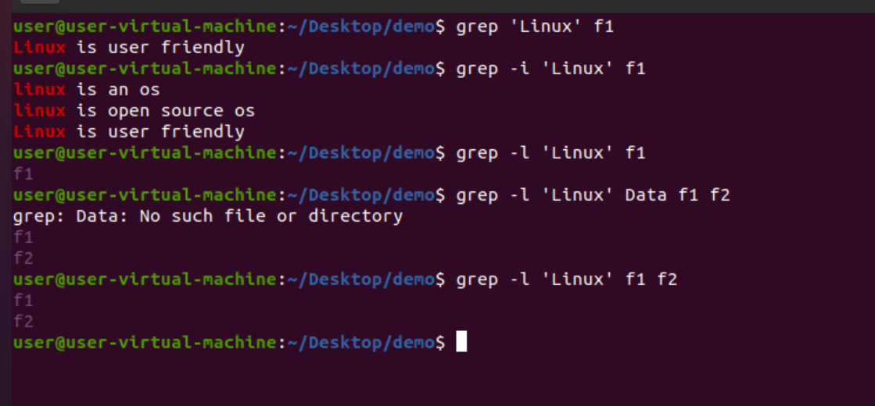
grep
grep is a command-line utility for searching plain-text data sets for lines that match a regular expression.

Slide 2

Grep -i
grep is a command-line utility for searching plain-text data sets for lines that match a regular expression by ignoring the case.

Slide 3
Grep –l
Displays the list of files the with the given pattern in content

Slide 4
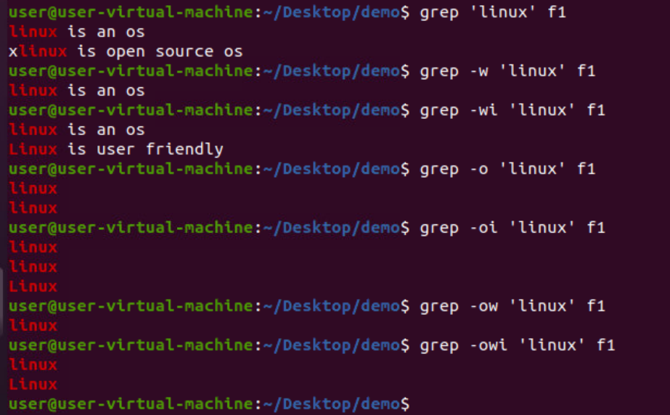
Grep 'pattern' 'pathname'
Displays all the lines with matching pattern including the substrings

Slide 5
Grep -w
DISPLAYS ALL THE LINES WITH MATCHING PATTERN excluding THE SUBSTRINGS

Slide 6
Grep -o
Displays the matching pattern in sub-string or string without displaying complete sentence

Slide 7
Grep -ow
DISPLAYS THE MATCHING PATTERN IN STRING WITHOUT DISPLAYING COMPLETE SENTENCE

Slide 8
Grep -oiw

Slide 9
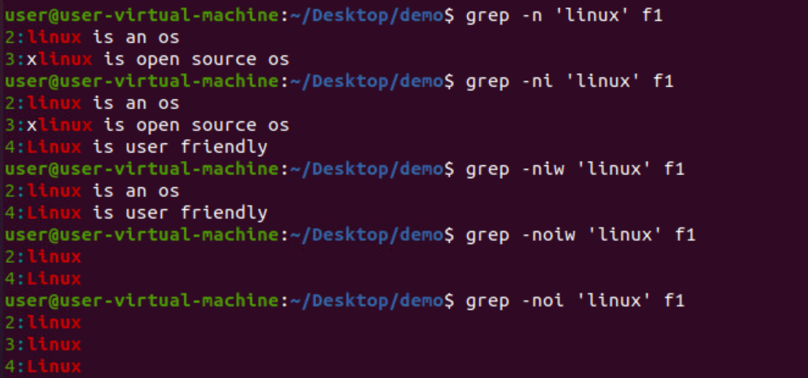
Grep -n
Displays the pattern including the line number

Slide 10

Grep -v
All the lines without the matching pattern will be displayed

Slide 11
Grep '^pattern'
Displays all the line starting with the given pattern

Slide 12
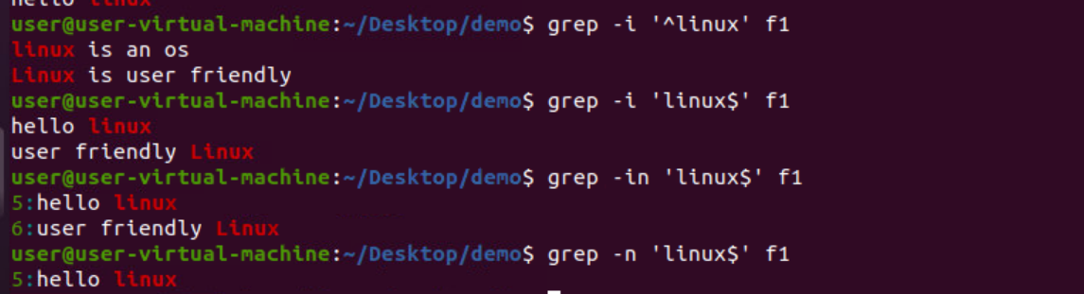
Grep 'pattern$'
DISPLAYS ALL THE LINE ending WITH THE GIVEN PATTERN

Slide 13
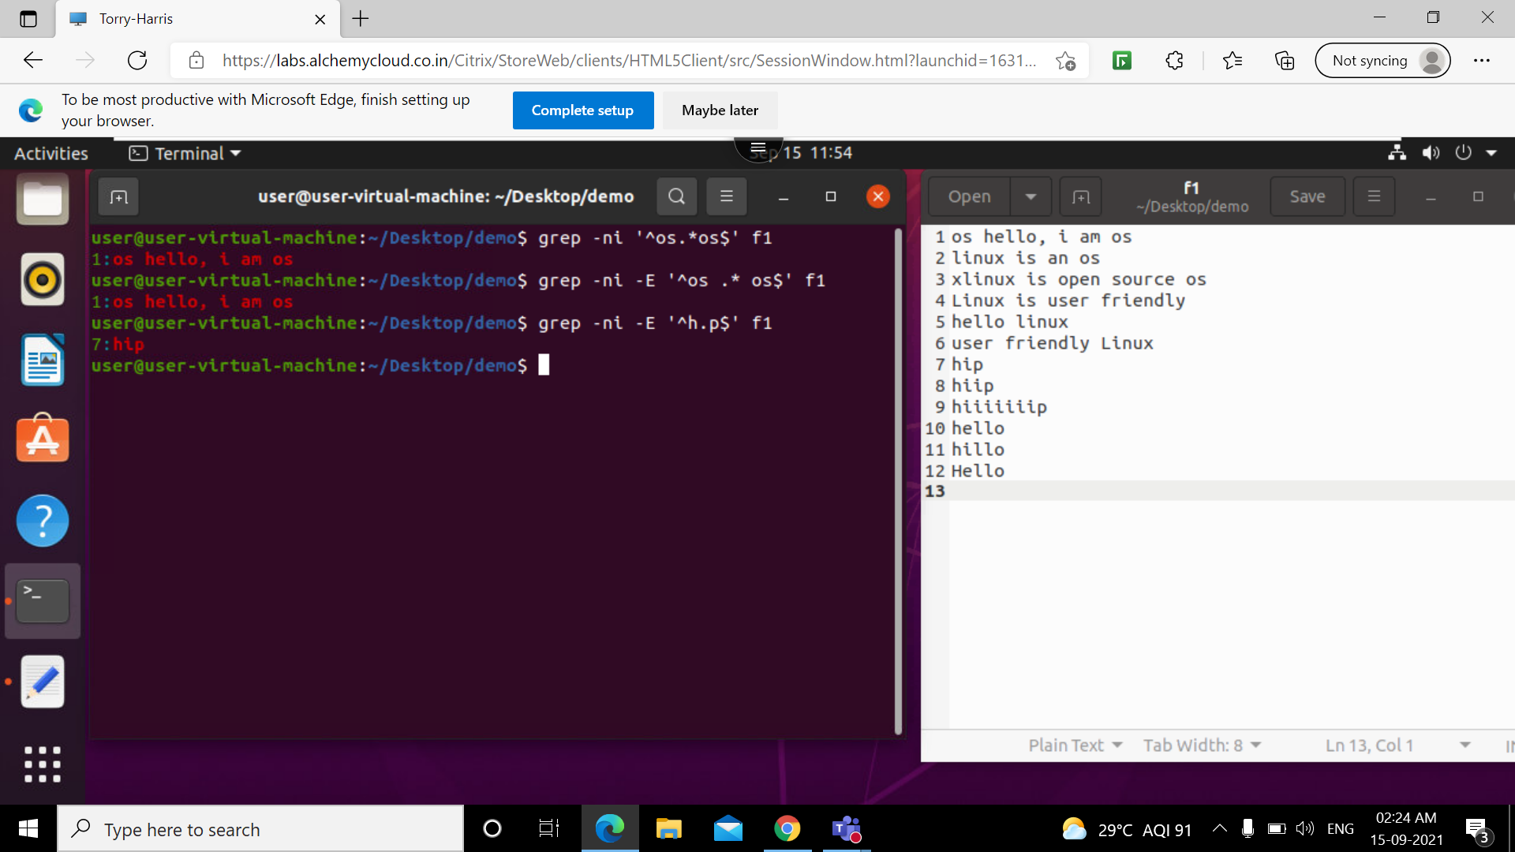
'^os.*os$'
Command to find sentence whichstarts and ends with os

Slide 14
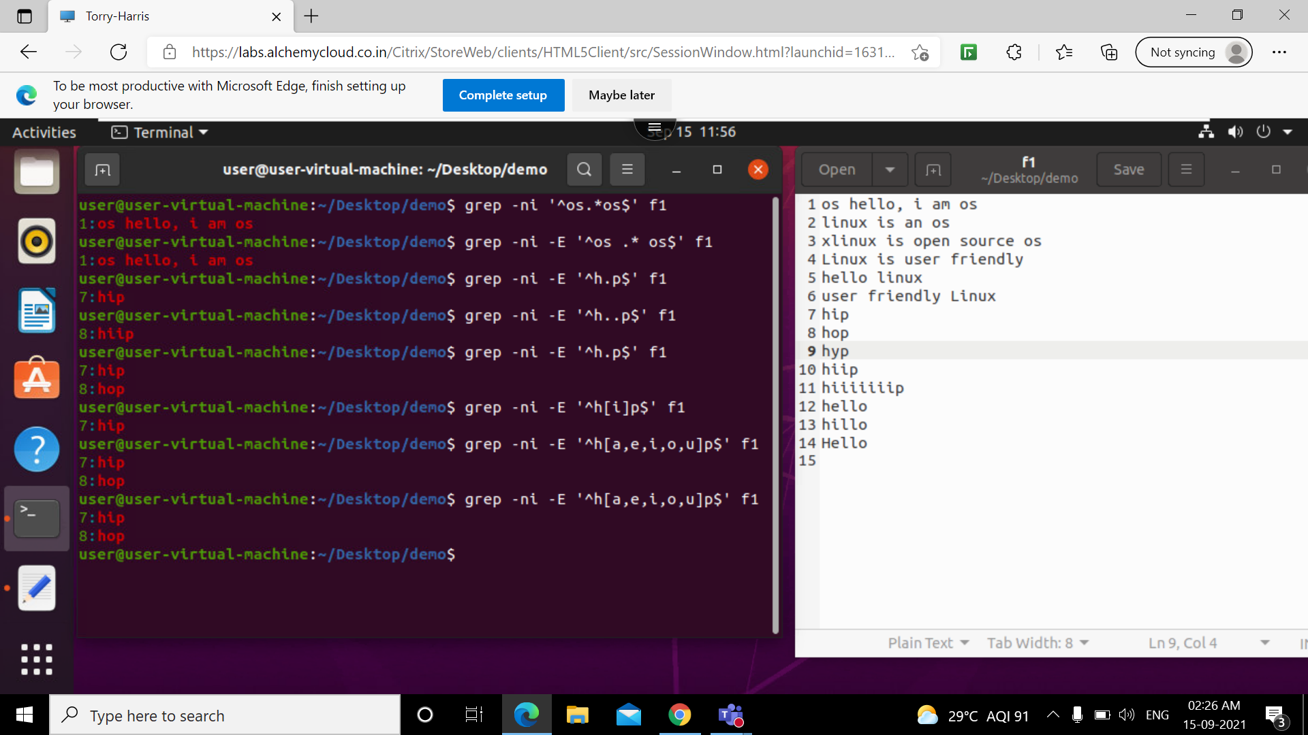
Regular expressions

Slide 15
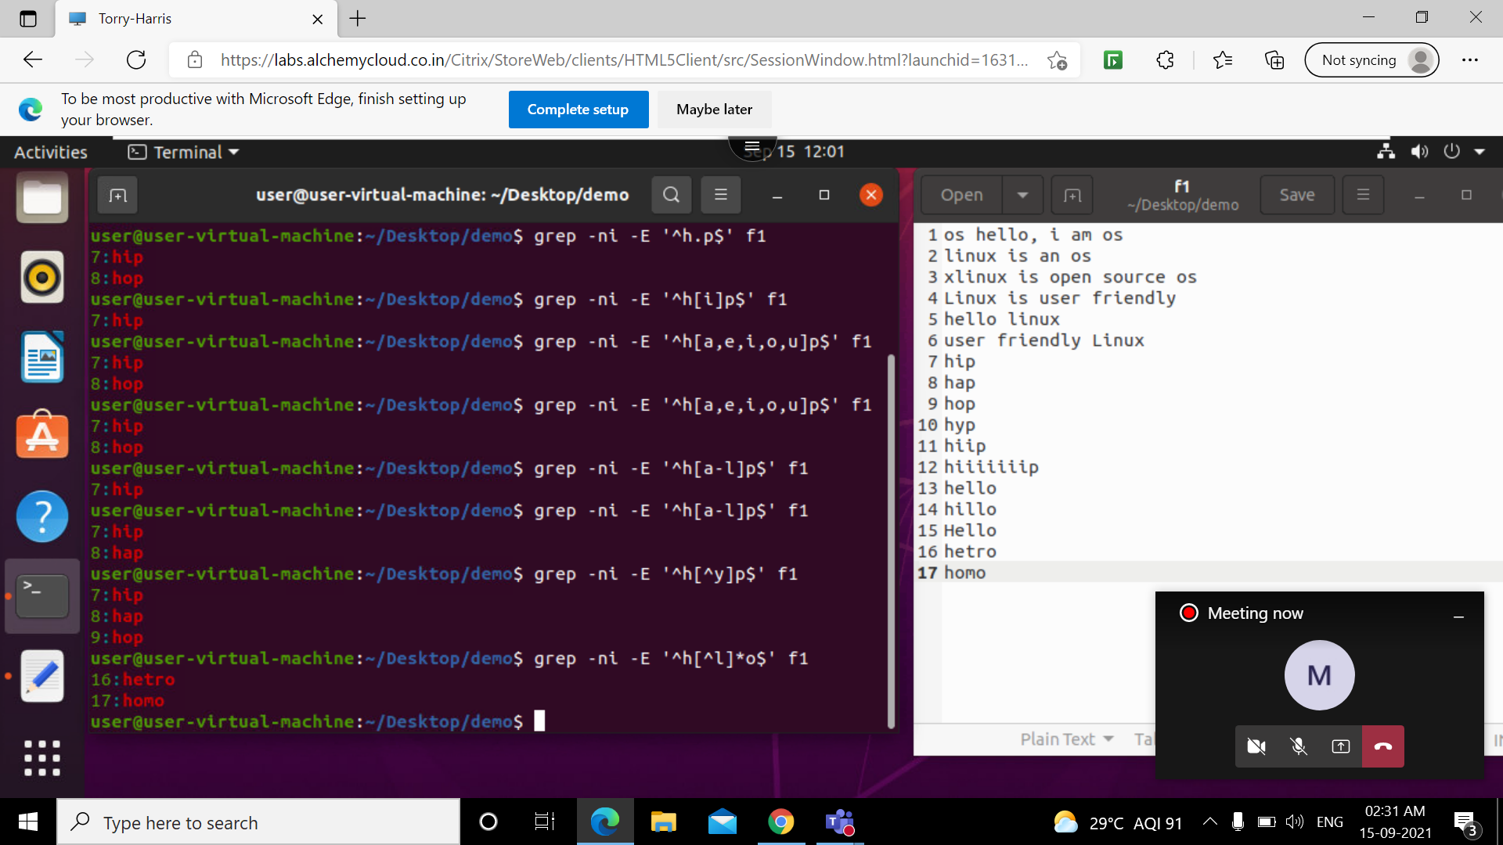

Slide 16
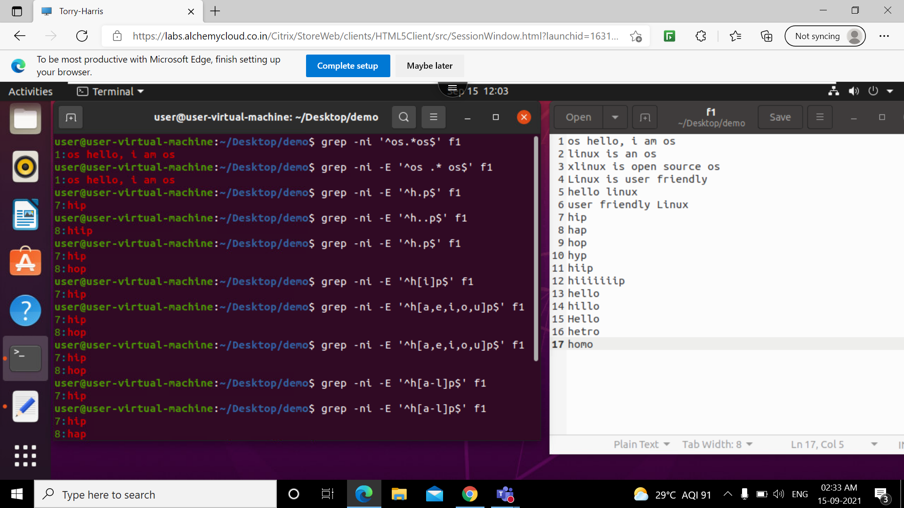
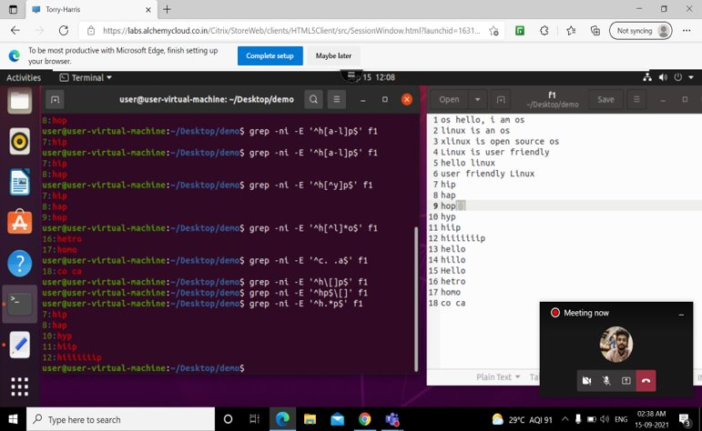

Slide 17
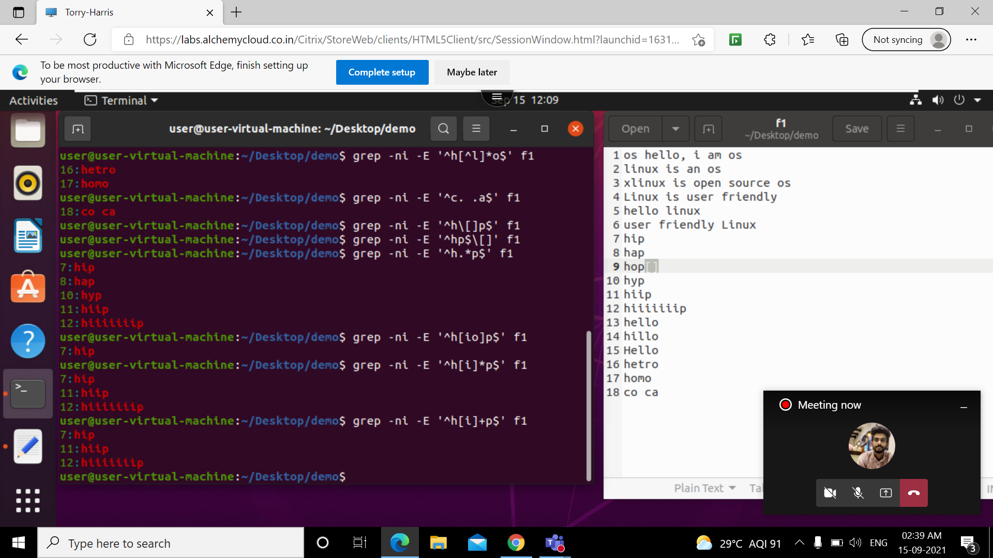
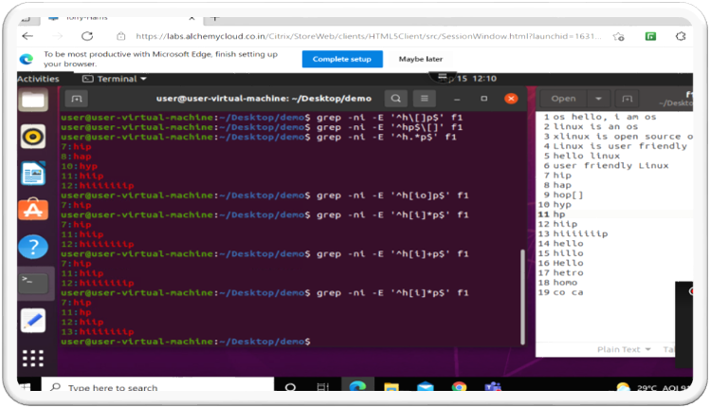

Slide 18
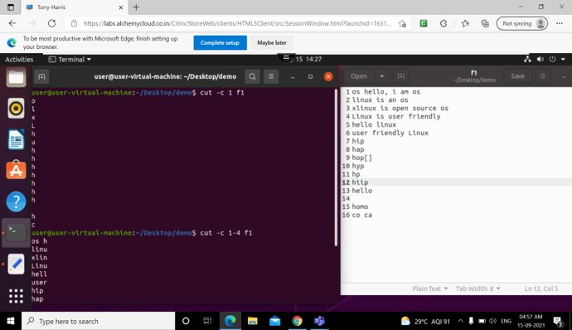
Cut -c
Used for slicing.Slicing is done based on columns

Slide 19
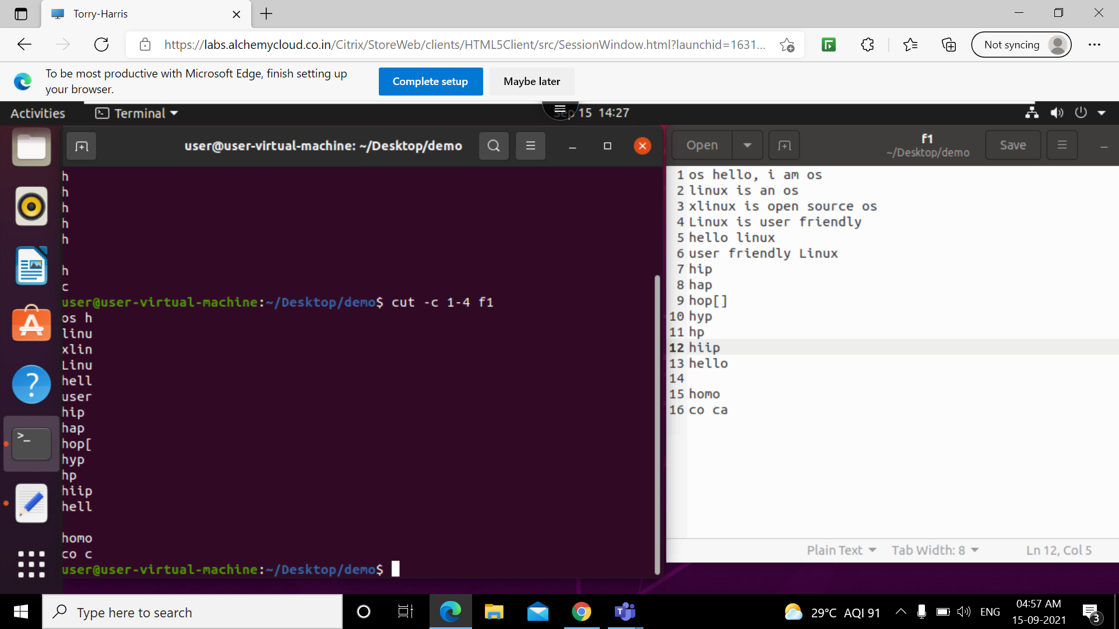
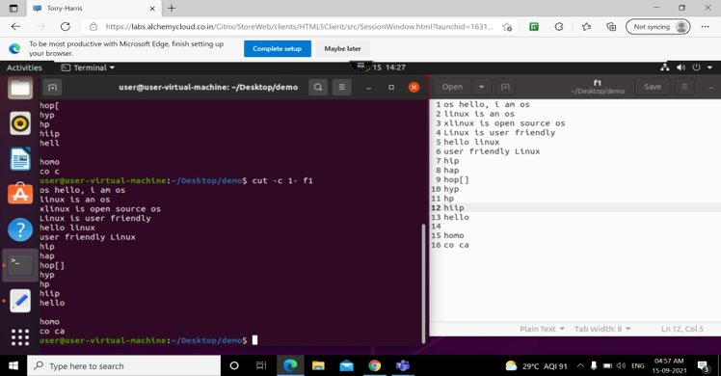

Slide 20
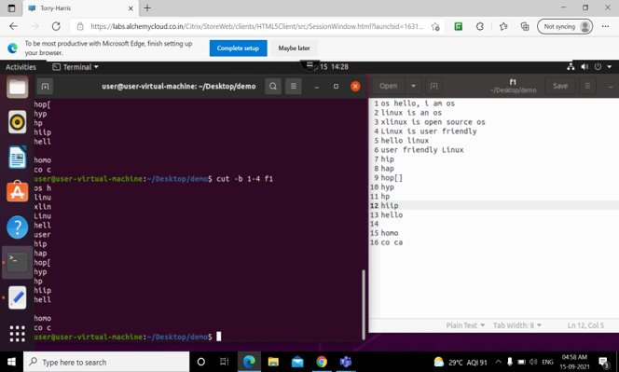
Cut -b
Slicing will be done based on bytes

Slide 21


Slide 22
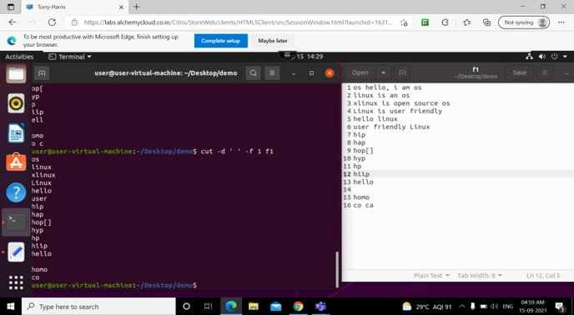
Cut –d(delimiter)

Slide 23



Slide 24

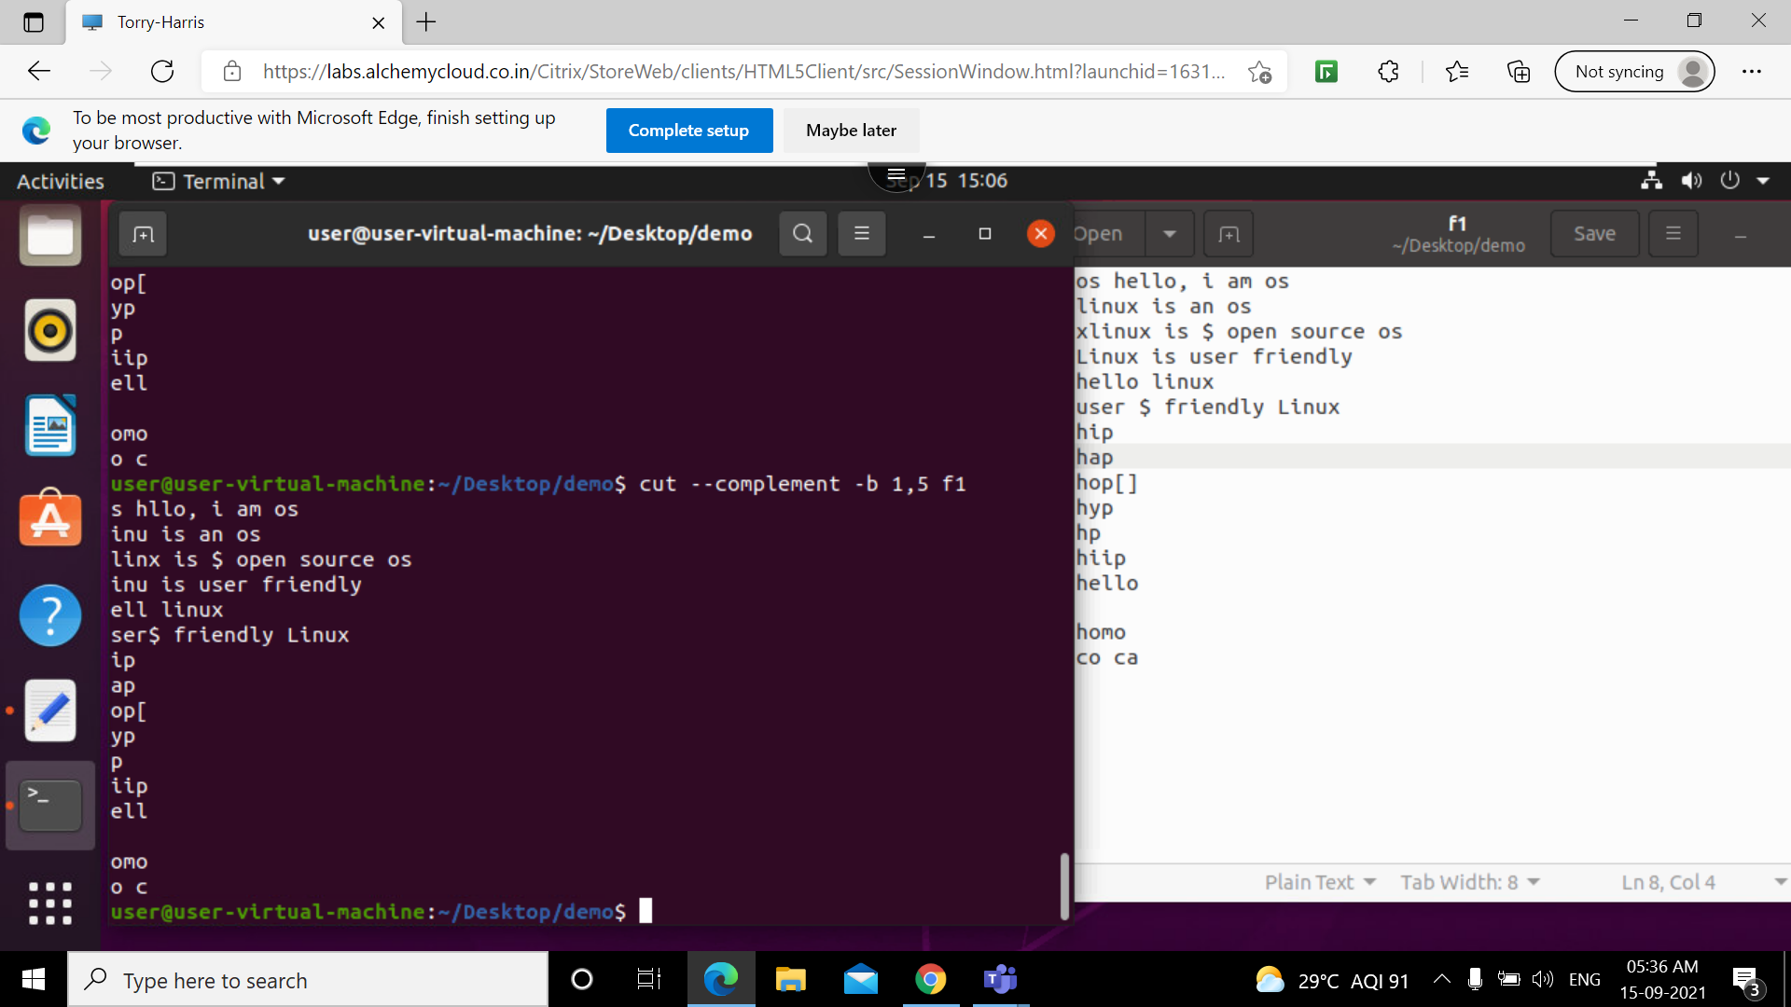
complement

Slide 25



Slide 26

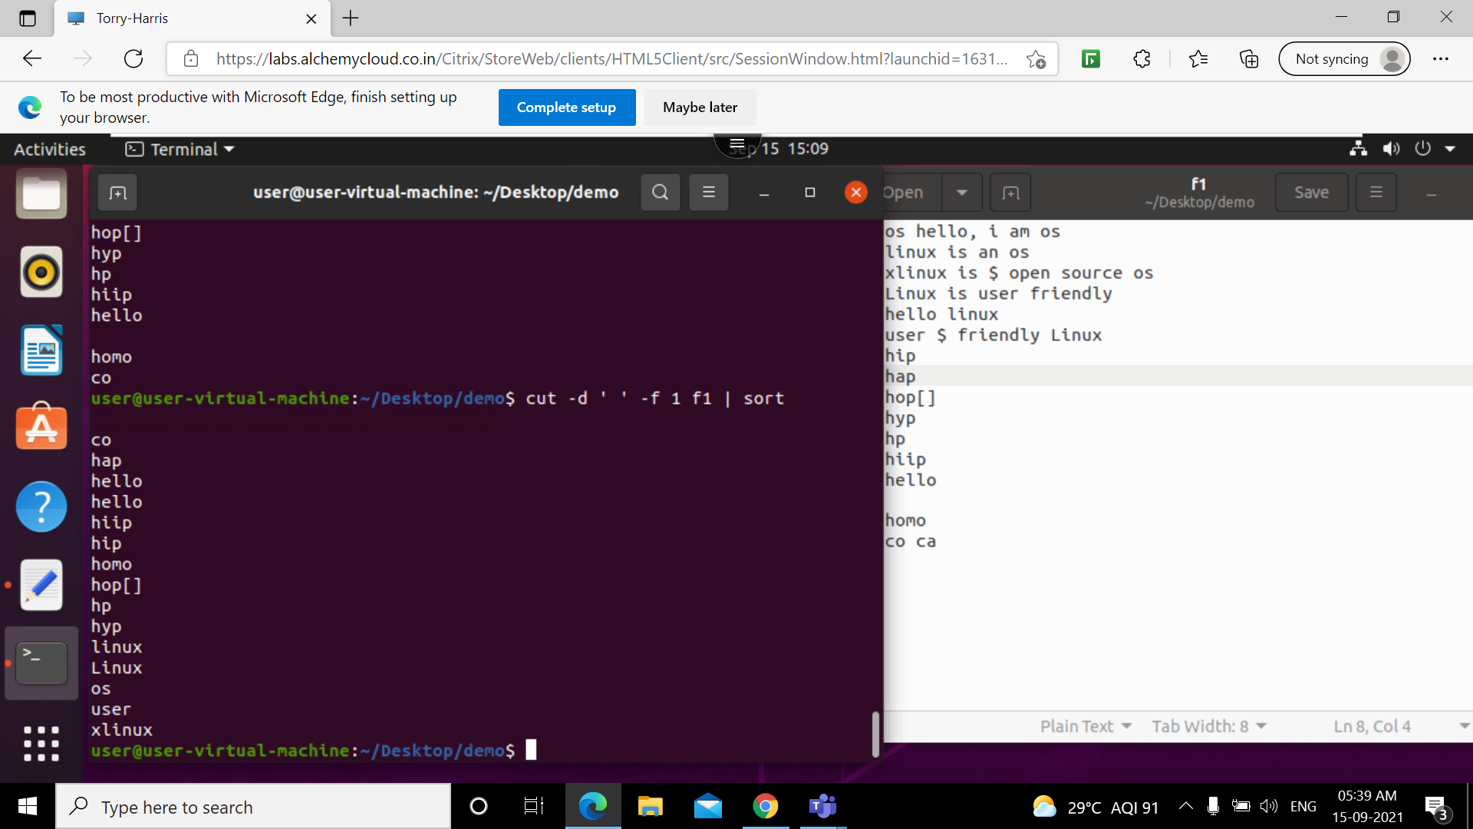

Slide 27
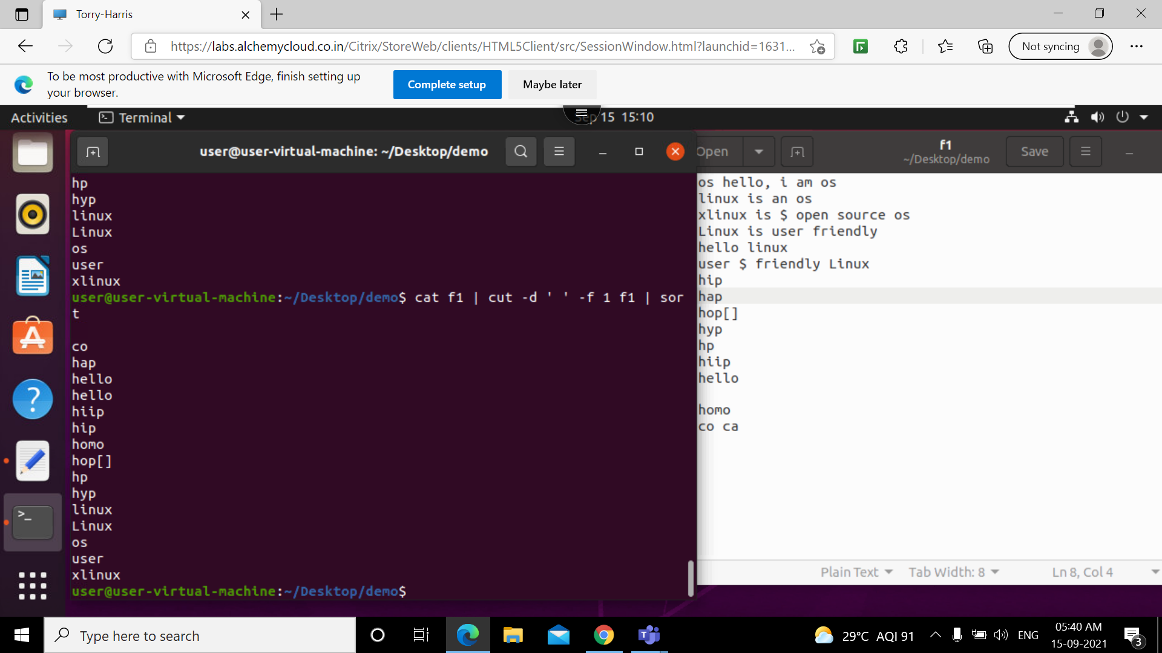

Slide 28
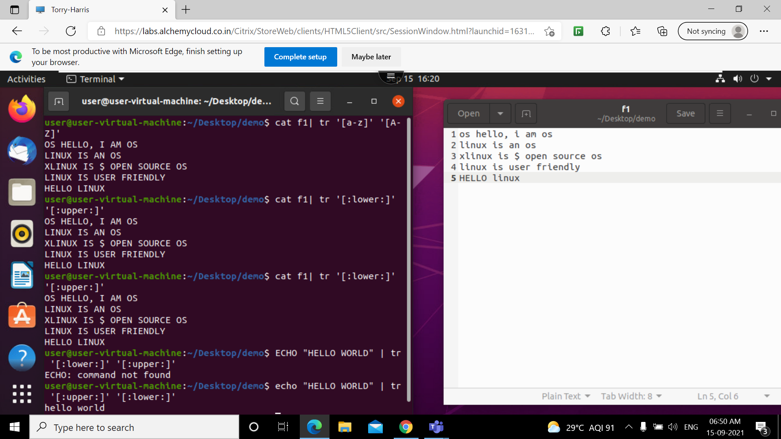
tr

Slide 29
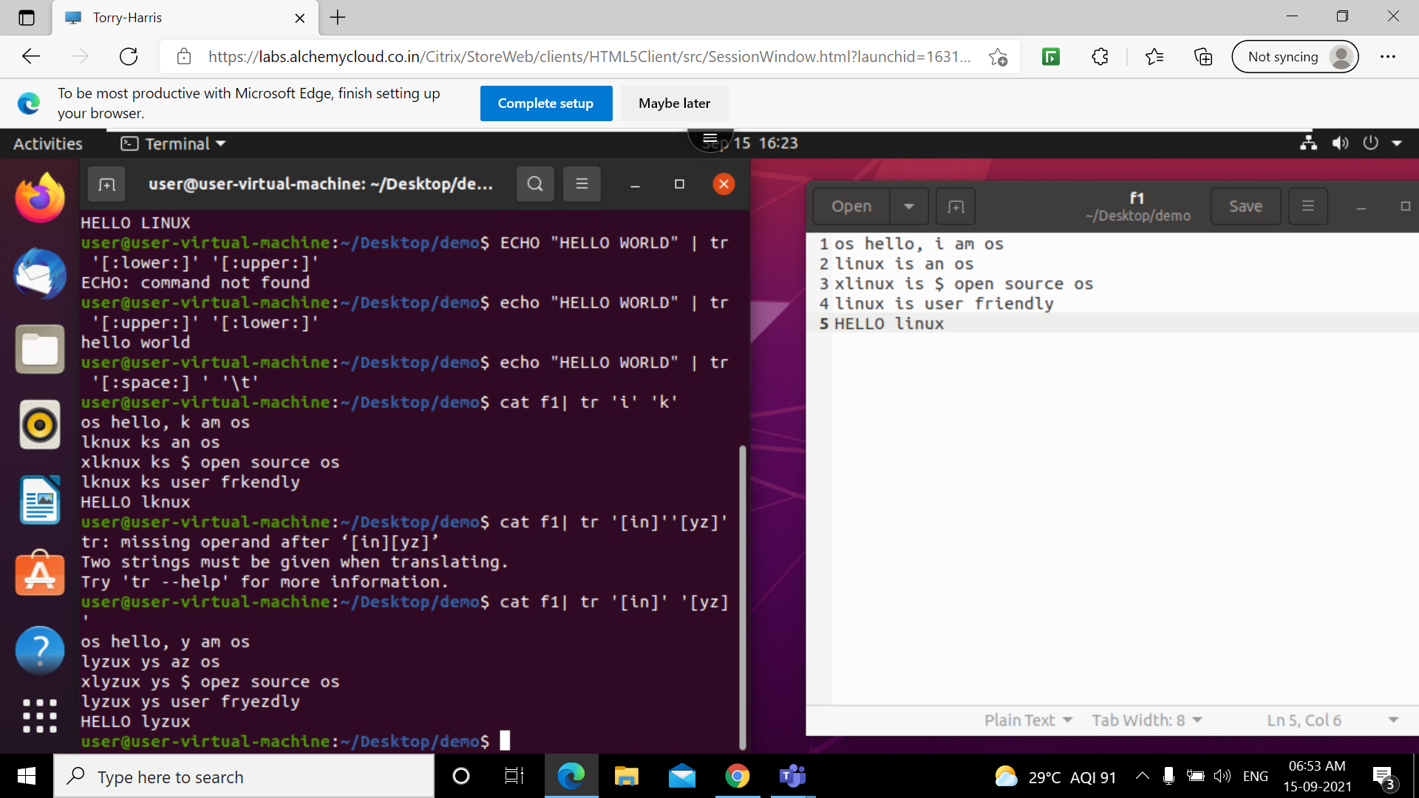
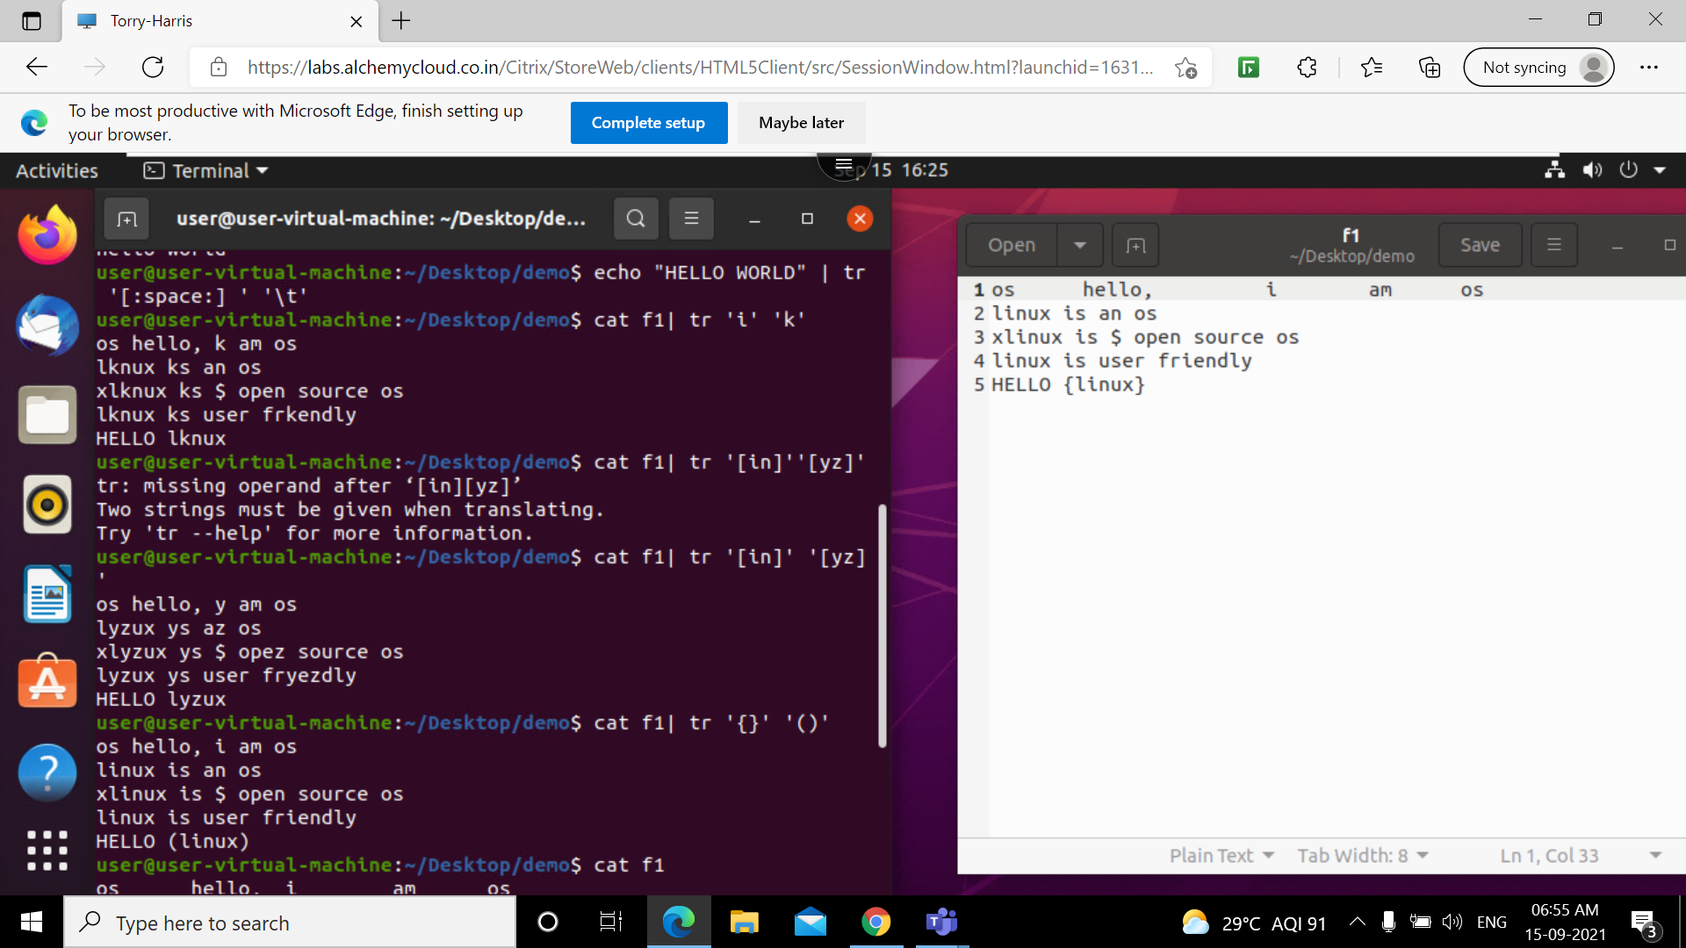

Slide 30
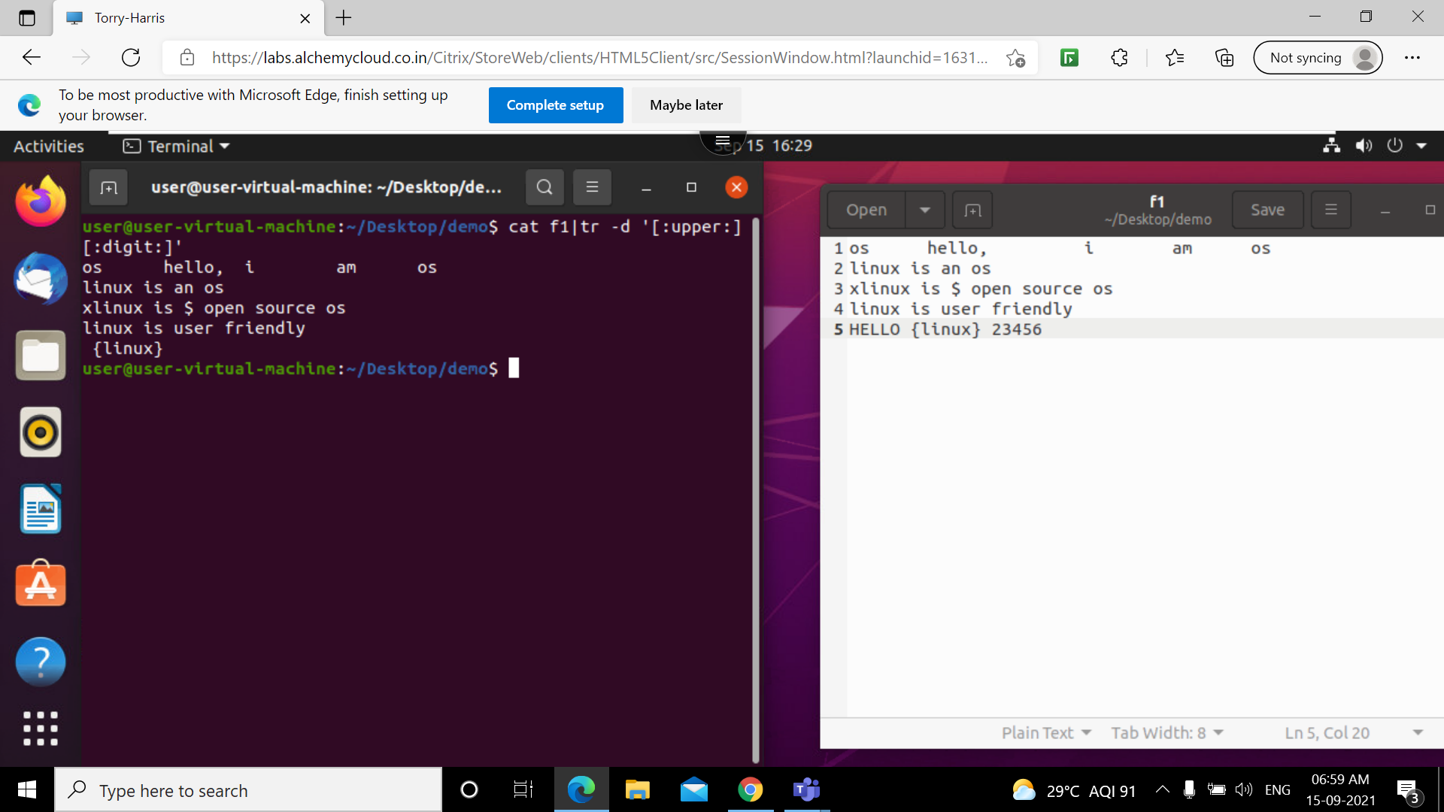


Slide 31
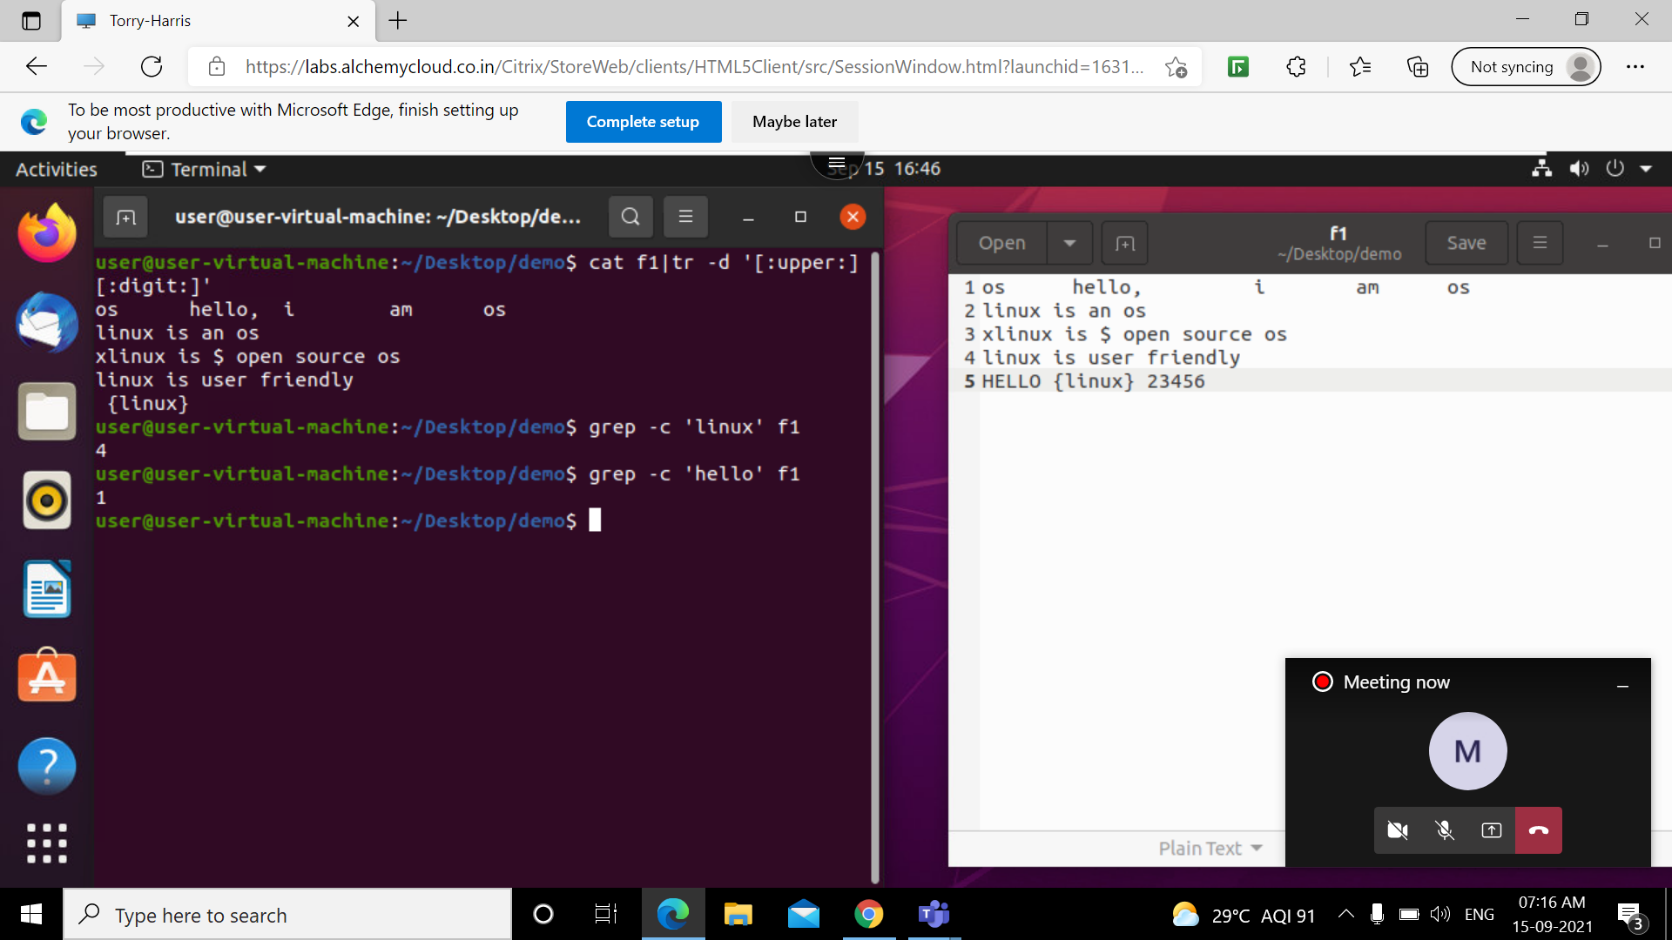
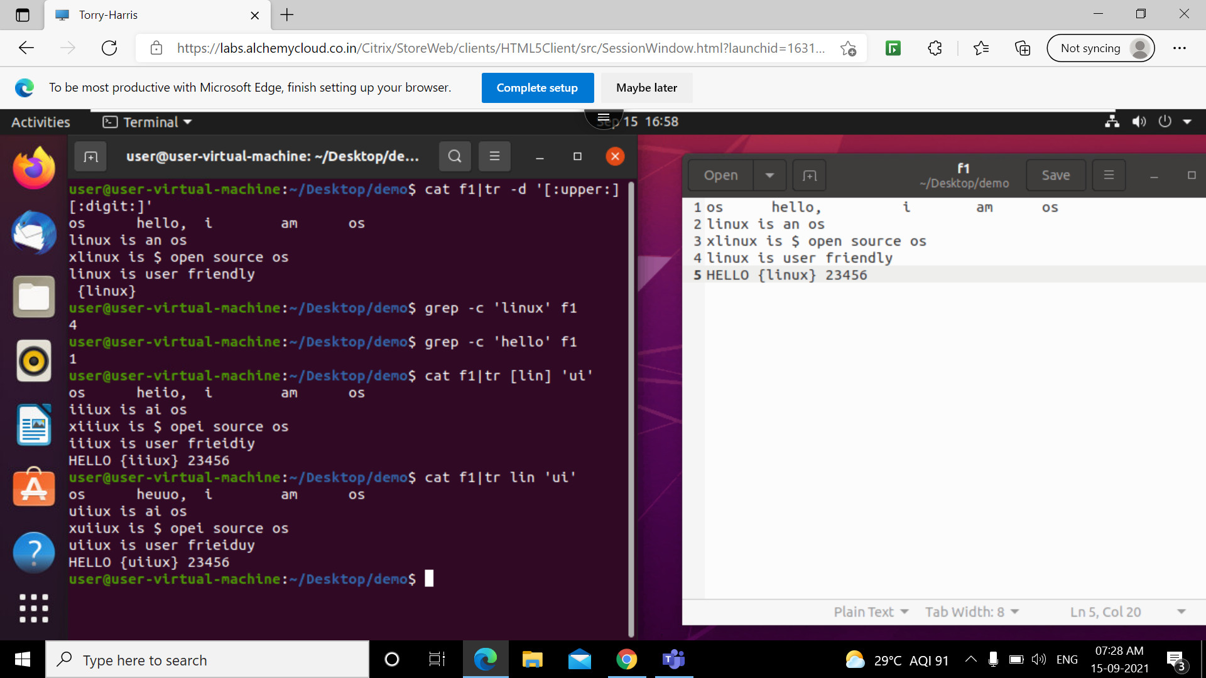

Slide 32
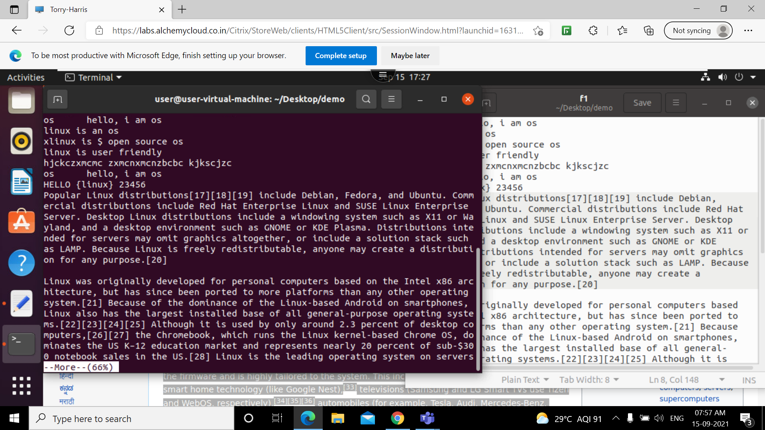
more

Slide 33
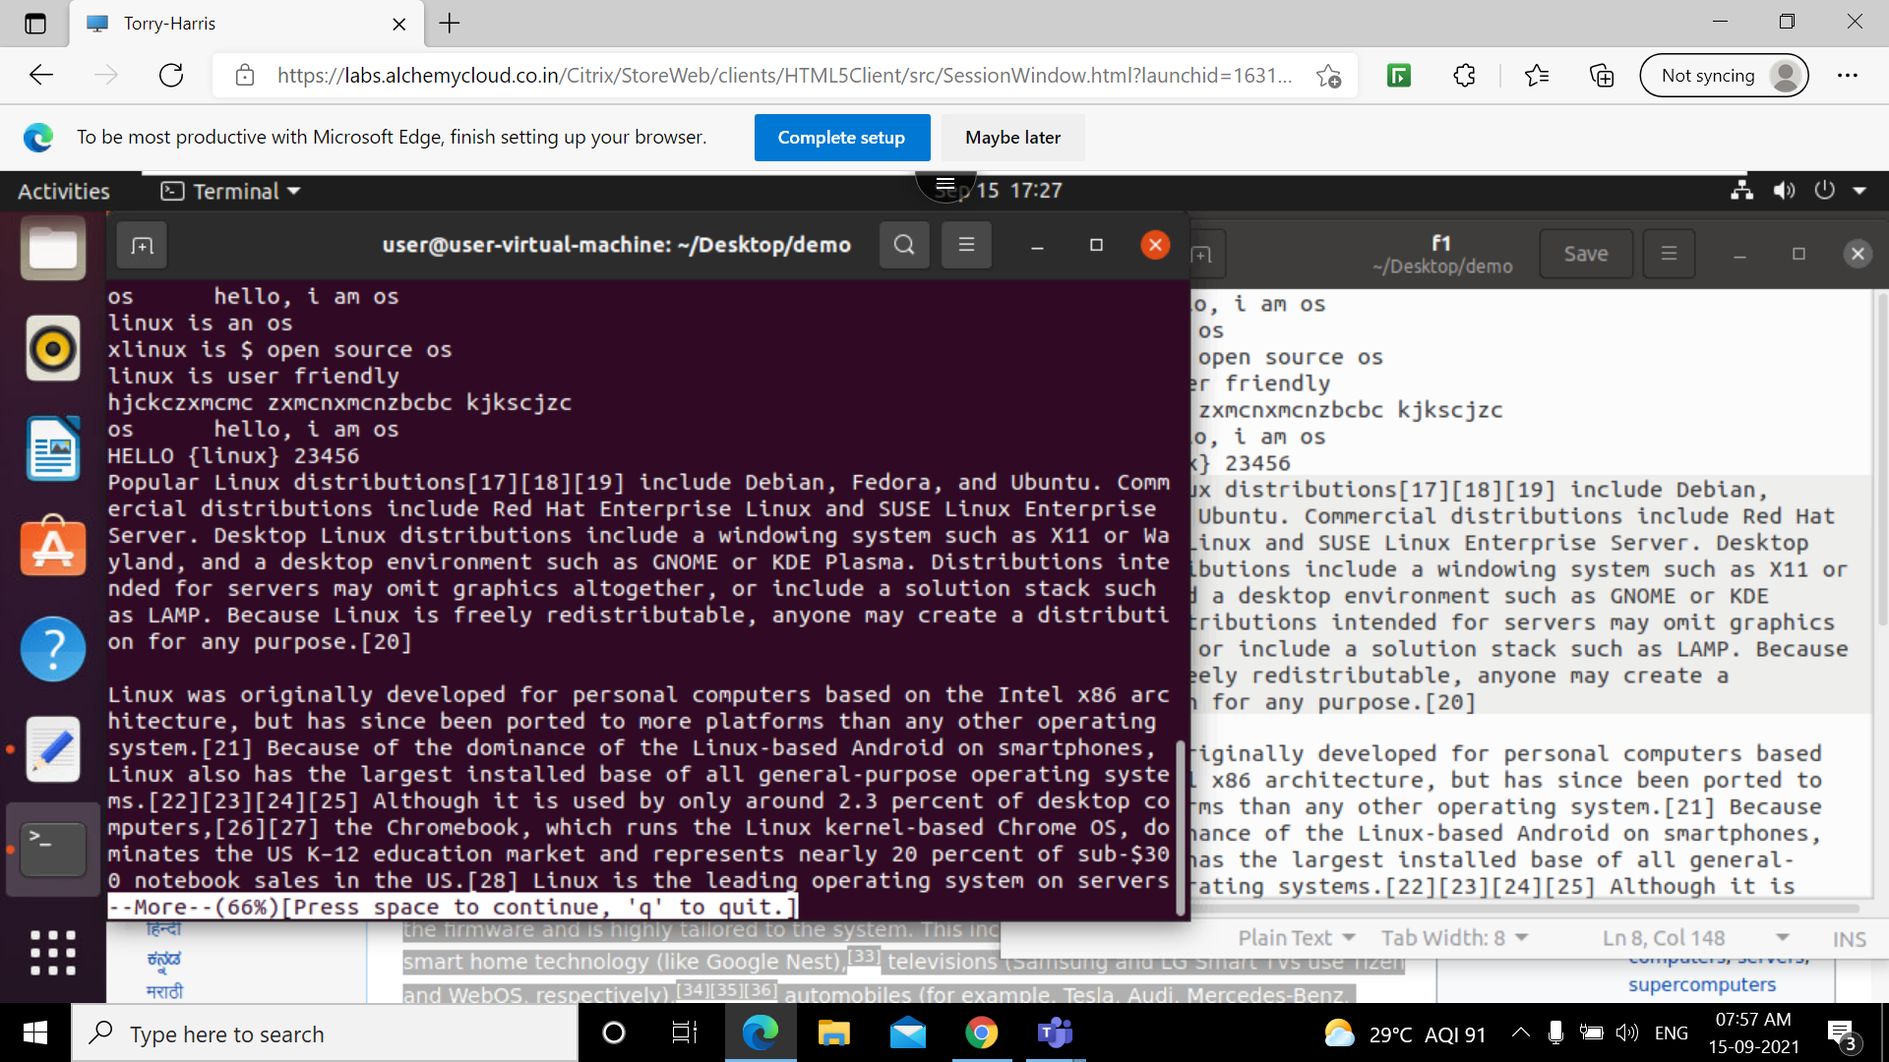
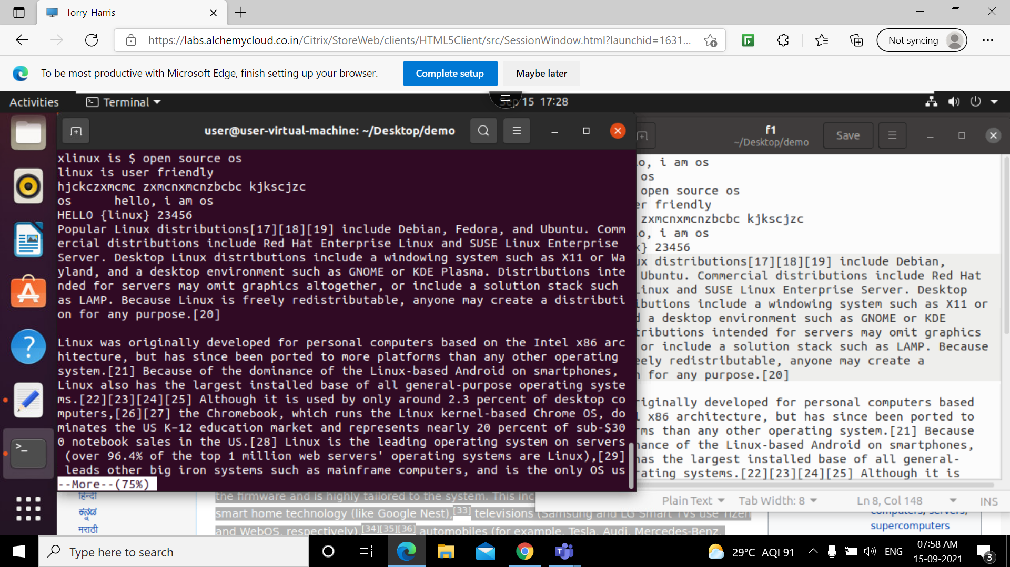
More –d option
More –p option

Slide 34
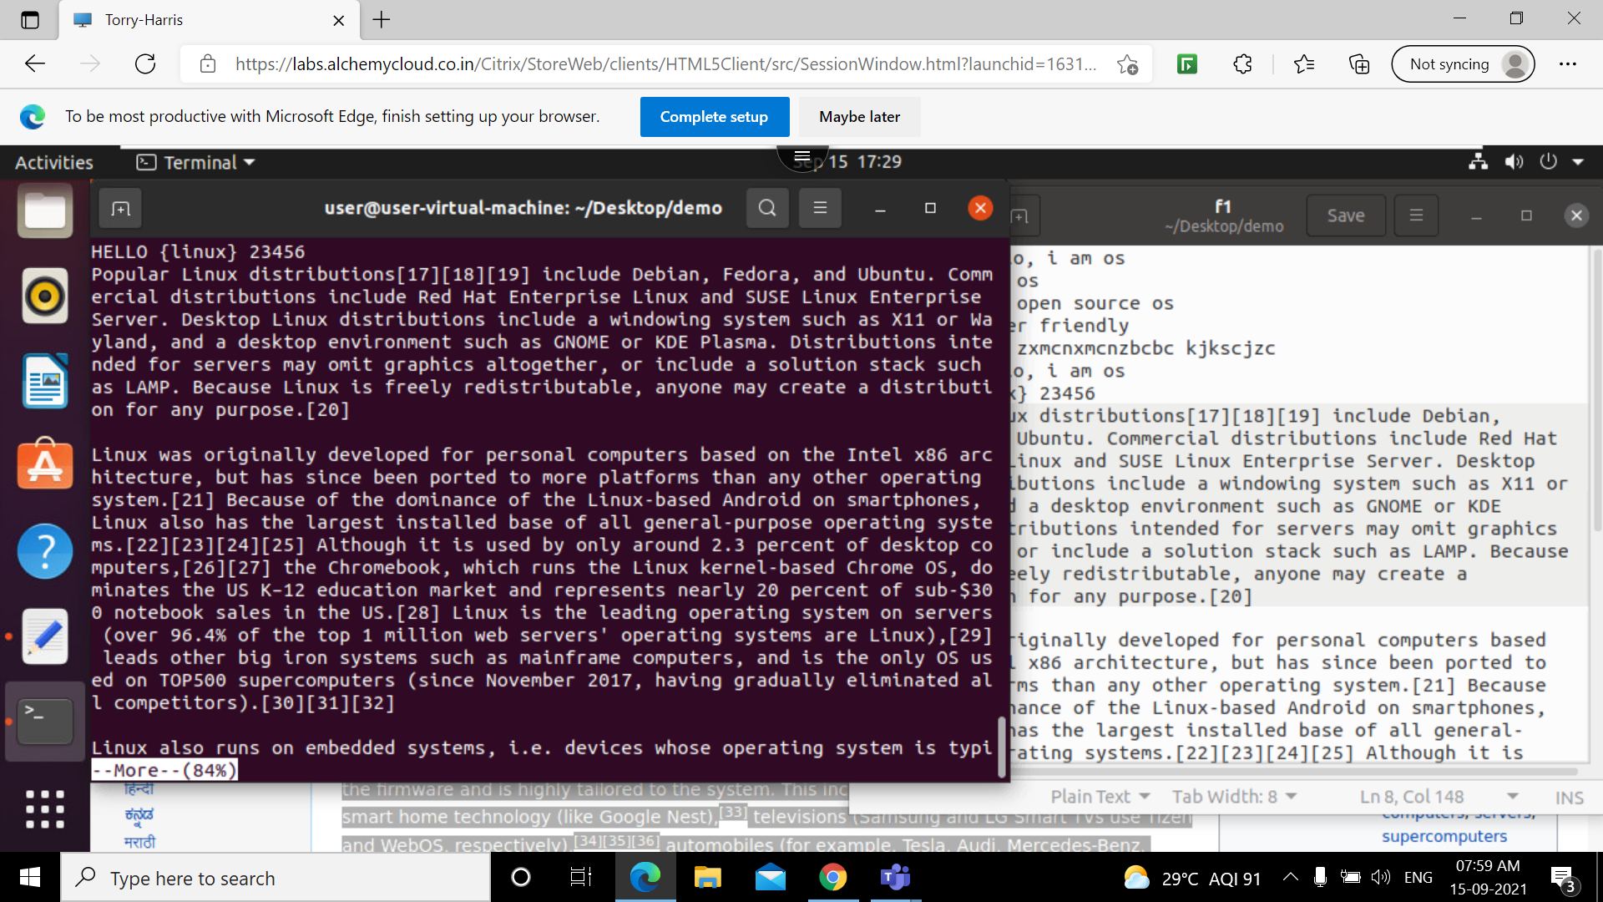
More –c option

